Slide 1

Basic Details of the Team and Problem Statement
Ministry/Organization Name/Student Innovation:
Ministry of Education
PS Code: SIH1433
Problem Statement Title: Mental Health and well-being surveillance, assessment and tracking solution among children.
Team Name: Bug Smashers
Team Leader Name: Rushikesh P. Shirke
Institute Code (AISHE):
Institute Name: P.R.Pote Patil College of Engineering and Management, Amravati
Theme Name: Smart Education

Slide 2
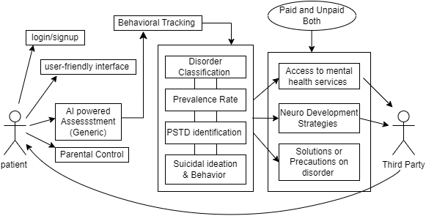


Idea/Approach Details
Creating Android or Web App for kids to access mental health services from home, addressing challenges.
Identifying the mental health of an individual through an generic assessment using Artificial Intelligence(AI) and tracking the real-time well-being surveillance of an individual.
Based on the First Generic Assessment results, another AI-powered assessment will perform the Behavioural Tracking.
Real-time behavioural tracking will include disorder classification, Prevalence rates, Post-Trauma Stress Disorder (PTSD) Identification and Suicidal Ideation and Behaviour. This will specify the extent of mental illness and urgency to seek medication.
Resting on the generated case-study, an individual will be benefited with the access to the mental health services, Neurodevelopment Strategies and suggestions on corresponding disorder.
Also paid and unpaid Third-Party counselling sessions will be provided within the application.
PTSD

Slide 3
Idea/Approach Details
Describe your Dependencies / Show stopper here
A platform for mental health surveillance based on Machine Learning models for identifying mental health patterns.
Providing data security and confidentiality for the users data and health conditions.
Integration with AI/ML models through API’s for better user experience and application performance.
A multilingual android and web-based application with Multi-Language Policy.
Once a user takes the assessment, an AI-powered 24/7 hotline chatbot is available to assists the user for well-being surveillance.
An AI-Model which uses the set of previous case-study and conclusions of case-study to enhance it’s own learning in the recursive manner. Thus, initiating towards self-trained Mental Health and well-being surveillance platform.
Describe your Use Cases here
Any individual concerned about their mental health can use this application, complete assessment questionnaire and receive instant feedback and mental health status.
Healthcare professionals can use the app during patient visits for initial screening. Identify potential mental health issues and provide immediate support or referrals.
Schools and workplaces can promote mental well-being among students and employees. Encourage users to regularly assess their mental health.
This solution aims to make mental health assessment and support easily accessible, confidential, and personalized, benefiting individuals, healthcare workers, and institutions alike.
For the purpose, we have collected some Psychological counselling parameters suggested by doctors.
Click here to view the document

Slide 4
Team Member Details
Team Leader Name: Rushikesh Prakash Shirke
Branch (Btech/Mtech/PhD etc): B.E. Stream (ECE, CSE etc): CSE Year (I,II,III,IV): IV
Team Member 1 Name: Shreyas Sanjaykumar Patil
Branch (Btech/Mtech/PhD etc): B.E. Stream (ECE, CSE etc): CSE Year (I,II,III,IV): IV
Team Member 2 Name: Shivraj Arvind Kadam
Branch (Btech/Mtech/PhD etc): B.E. Stream (ECE, CSE etc): CSE Year (I,II,III,IV): III
Team Member 3 Name: Sanika Dipak Kale
Branch (Btech/Mtech/PhD etc): B.E. Stream (ECE, CSE etc): CSE Year (I,II,III,IV): IV
Team Member 4 Name: Arpita Vilasrao Dolas
Branch (Btech/Mtech/PhD etc): B.E. Stream (ECE, CSE etc): CSE Year (I,II,III,IV): III
Team Member 5 Name: Nama Z. Choudhari
Branch (Btech/Mtech/PhD etc): B.E. Stream (ECE, CSE etc): CSE Year (I,II,III,IV): IV
Team Mentor 1 Name: Dr. V.B. Kute
Category : Academic Expertise : Problem Solving & Psychology Domain Experience (in years): 23
Team Mentor 2 Name: Dr. Z.I. Khan
Category : Academic Expertise : Algorithmics & ML Domain Experience (in years): 14

